Slide 1
Chapter 6 The Economic Cooperation Function of International Organizations

Slide 2
Section one International Organizations and the Development of International Trade

Slide 3
I. Evolution of the International Trade Regime
1. Late 19th – early 20th century: regulation was carried out unilaterally or bilaterally; no international body existed to exercise macro-level adjustment over the world economy.
2. First half of the 20th century: initial attempts were made to safeguard international trade order through multilateral mechanisms, including the creation of international organizations.
3. October 1946: the first preparatory session of the “World Trade and Employment Conference” convened in London and resolved to establish a Charter Drafting Committee to prepare the constitution of an International Trade Organization.
4. November 1947 – March 1948: adoption of the Havana Charter.
5. 1 January 1948: entry into force of the General Agreement on Tariffs and Trade (GATT).
6. 1 January 1995: establishment of the World Trade Organization (WTO).

Slide 4
(I) General Agreement on Tariffs and Trade
Purpose:
- Raise living standards, ensure full employment, secure steady growth of real income and effective demand, make full use of world resources, expand production and exchange of goods, and promote economic development;
- Regulate mutual relations in trade and economic development, mutually reduce tariffs, eliminate trade barriers and discriminatory treatment, and achieve trade liberalization.
Principles:
- Free trade;
- Non-discrimination;
- Reciprocity;
- Transparency;
- Elimination of quantitative restrictions;
- Anti-dumping and restrictions on export subsidies.

Slide 5
(II) Other Types of International Organizations
1. Council for Mutual Economic Assistance (CMEA, established 1949) – Objective: to coordinate trade relations among the Soviet Union and Eastern-bloc countries.
2. United Nations Conference on Trade and Development (UNCTAD, established 1964) – Objective: to formulate principles on international trade and related development issues, help developing countries secure trade and investment opportunities, and foster the evolution of multilateral trade agreements.
3. Organization of the Petroleum Exporting Countries (OPEC, established 1960) – Purpose: to protect, through a specialized producers’ organization, the national economic interests of raw-material producing and exporting countries.
4. Regional economic organizations
5. Forum-style multilateral coordination mechanisms, exemplified by the Group of Seven (G7) summit, which play a central role in coordinating macro-economic policies and stabilizing the world economy.

Slide 6
(III) World Trade Organization
- Established: 1 January 1995
- Marks the formation of a global multilateral trading system dedicated to free trade.
Organizational Structure
1. Ministerial Conference: the supreme authority, empowered to take decisions on any matter under the WTO’s purview.
2. General Council: exercises the functions of the Ministerial Conference between its sessions, carries out all duties assigned by the WTO Agreement, and oversees subsidiary councils and committees.
3. Dispute Settlement Mechanism: addresses trade disputes among WTO members; its rulings are legally binding on the parties.
4. Secretariat: handles the day-to-day work of the WTO.

Slide 7
II. Activities and Approaches of International Organizations in International Trade
Functions of the World Trade Organization:
Implement, administer and operate the WTO Agreement and the multilateral trade agreements;
Continue to provide a forum for negotiations under the existing agreements and a venue for negotiations on new issues and new rounds;
Administer and implement the Understanding on Rules and Procedures Governing the Settlement of Disputes (Annex 2);
Administer and implement the Trade Policy Review Mechanism (Annex 3);
Cooperate with other international organizations to coordinate the formulation of global economic policies;
Provide technical assistance and training to assist developing, and especially least-developed, country members.

Slide 8
(I) Activities and Methods of the World Trade Organization
1) Organizing multilateral trade negotiations is the WTO’s principal means of advancing trade liberalization.
Doha Round Negotiations
2) The Trade Policy Review Mechanism is the WTO’s key instrument for overseeing the operation of the international trading system.
Country-specific trade-policy reviews, pioneered by the WTO
Purpose: examine the impact of members’ trade policies and practices on the multilateral trading system
Format: convene Trade Policy Review Body meetings and conduct collective-based monitoring
3) The Dispute Settlement Mechanism is the backbone of the WTO legal system and the final safeguard for securing multilateral trade liberalization.
Purpose: resolve trade disputes between members through effectively enforced rulings, prevent trade conflicts, and ensure that the rights and obligations of the contracting parties are upheld.

Slide 9
(II) Regional International Organizations
- Regional trading arrangements
Forms:
- Preferential trade agreements, free-trade areas, customs unions, common markets, economic unions, etc.
Objective:
- Remove obstacles to economic development within the region and achieve rational movement and efficient allocation of economic factors.

Slide 10
III. Impetus of International Organizations to International Trade Development
- Established operational rules for international trade and fostered the progressive development and improvement of the relevant legal system.
- Accelerated worldwide trade liberalization.
- Manage and supervise the normal functioning of international trade activities.
- Provide a legal framework and institutional safeguards for the settlement of international trade disputes.

Slide 11
Section two International Organizations and International Financial Cooperation

Slide 12
International Financial Cooperation
- International finance:
The turnover and movement of monetary funds among countries or regions arising from economic, political and cultural links; banks, finance companies, investment firms, securities companies and other financial institutions operate monetary funds through foreign exchange, bonds, stocks and other instruments to effect cross-border transfers of capital.
Global financial organizations: represented by the International Monetary Fund and the World Bank
Regional financial organizations: Asian Development Bank, African Development Bank, Inter-American Development Bank, etc.

Slide 13
I. Evolution of the International Financial Mechanism
1. 19th century: the gold-standard monetary system.
2. 1929–1933: complete collapse of the gold standard; emergence of exclusive currency blocs centered on national currencies.
3. December 1945: establishment of the International Monetary Fund and the International Bank for Reconstruction and Development; creation of the Bretton Woods system—a dollar-centered international monetary order.
4. 1978: the Jamaica system—introduced a dollar-centered, diversified system of international reserves and floating exchange rates.
5. Post-1980s: wave of financial-liberalization reforms.
6. April 2009: G20 London Summit—decision to create the Financial Stability Board.

Slide 14
(I) International Monetary Fund
Organizational structure
- Board of Governors: highest authority
- Executive Board: handles day-to-day operations
- Managing Director: chief executive
Main activities
- Formulate and implement rules for the international monetary system
- Oversee members’ exchange-rate arrangements and economic policies
- Provide short-term loans when members face balance-of-payments imbalances
- Offer technical assistance on fiscal, monetary, banking and foreign-trade issues through training, resident representatives and experts

Slide 15
(II) International Bank for Reconstruction and Development (World Bank)
World Bank Group:
- World Bank
- International Development Association
- International Finance Corporation
- International Centre for Settlement of Investment Disputes
- Multilateral Investment Guarantee Agency
Common objective:
Promote economic development and social progress of member countries, reduce poverty, and improve living standards.
Main organs:
- Board of Governors
- Executive Directors

Slide 16
(II) International Bank for Reconstruction and Development (World Bank)
Main activities:
- Provide long-term loans for productive purposes to member governments, government agencies, or private enterprises guaranteed by governments.
- Dispatch missions to borrowing countries for on-site assessments and provide technical assistance

Slide 17
(II) International Bank for Reconstruction and Development (World Bank)
Four affiliated institutions:
1. International Development Association (IDA) – established 1960; provides long-term, interest-free or low-interest loans to low-income developing countries.
2. International Centre for Settlement of Investment Disputes (ICSID) – established 1966; settles investment disputes between investors and host states through conciliation and arbitration.
3. Multilateral Investment Guarantee Agency (MIGA) – established 1988; offers long-term political-risk insurance to investors, promotes foreign investment in developing countries, and helps those countries attract investment by supplying technical assistance and resources.
4. Bank for International Settlements (BIS) – established 1930; fosters cooperation among central banks, facilitates international financial operations, and acts as trustee or agent in international settlement business.

Slide 18
(III) Regional International Organizations
1. Inter-American Development Bank (IDB) – formally began operations in October 1960. Main activities: provide loans to foster economic development in Latin America, help member states expand trade, and furnish technical cooperation for the preparation, planning, and implementation of development programs and projects.
2. African Development Bank (AfDB) – commenced operations in July 1966. Main activities: promote the economic development and social progress of member states by extending investments and loans that mobilize Africa’s human and natural resources; give priority funding and technical assistance to projects that enhance regional economic cooperation and enlarge intra-regional trade; assist members in studying, formulating, coordinating, and executing economic development plans to achieve African economic integration.
3. Asian Development Bank (ADB) – began operations in December 1966. Mandate: advance social and economic development and cooperation in the Asia-Pacific region, and help developing members in the region accelerate their economic growth.
4. European Bank for Reconstruction and Development (EBRD) – started operations in April 1991. Main activities: extend loans, technical assistance, and personnel training to infrastructure and private-sector projects in recipient countries; help governments devise policies and measures; participate in establishing financial institutions and systems.
5. Asian Infrastructure Investment Bank (AIIB) – began operations in January 2016. Core business: finance infrastructure development projects across the Asia-Pacific region.

Slide 19
II. Role of International Organizations in Promoting International Financial Cooperation
- International financial organizations have established universally accepted principles and norms for the financial sector and effectively oversee the functioning of the international financial system.
- They are committed to eradicating poverty and resolving debt crises, providing technical and financial assistance to member states, especially developing countries.
- These organizations play an irreplaceable role in rescuing countries from international financial crises.
- Their activities accelerate the processes of financial liberalization and financial globalization.

Slide 20
Section three International Organizations and Multilateral Aid

Slide 21
International Multilateral Aid
Definition:
assistance delivered through international organizations to sovereign states in the form of grants or concessional goods, funds, technology, etc., aimed at resolving the recipient’s political or economic difficulties.

Slide 22
I. Evolution of the International Multilateral Aid Mechanism
- In the second half of the 19th century, humanitarian aid ideas and practices gradually developed in Europe.
- After World War II, modern international aid formally emerged to heal war wounds and eradicate poverty, hunger and disease, while the Cold War structure took shape.
- The wave of national-liberation movements in the 1950s–1960s ushered in a peak period for the expansion of international multilateral aid.

Slide 23
I. The Evolution of International Multilateral Aid Mechanisms
- By the late 1960s, economic recession and restructuring in Western countries, coupled with a temporary détente in U.S.-Soviet relations, brought international aid expansion to a standstill.
- The oil and financial crises of the 1970s triggered a sharp increase in the volume of international multilateral aid.
- After the 1980s, neoliberal ideas and the “Washington Consensus” became the dominant doctrines guiding international aid.

Slide 24
I. Evolution of International Multilateral Aid Mechanisms
- After the Cold War, the overall volume of multilateral aid declined.
- Transition countries emerging from the upheavals in Eastern Europe and the dissolution of the Soviet Union became the primary targets of multilateral assistance.
- The actors in international aid became more diversified; a large number of non-governmental international organizations entered humanitarian and development fields.

Slide 25
II. Multilateral Aid Activities and Approaches of International Organizations
The United Nations and other international organizations play a leading role in international multilateral aid.

Slide 26
(I) Multilateral Aid Activities and Modalities within the United Nations System
Agencies of the United Nations system working on social and economic development focus on technical and humanitarian assistance.
1) United Nations Development Programme (UNDP)
- Funding: Primarily through voluntary contributions from member states.
- Core functions:
Assist countries in addressing global and national development challenges, help developing countries attract and effectively utilize aid, and provide professional advice, training and other support measures.
- Sectors of assistance:
Democratic governance, poverty reduction, crisis prevention and recovery, environment and energy, HIV/AIDS, etc.

Slide 27
(I) Multilateral Aid Activities and Modalities within the United Nations System
2) United Nations Children's Fund (UNICEF)
Funding sources: Voluntary contributions from governments, intergovernmental organizations, NGOs, businesses and individuals.
Core functions:
Address malnutrition, disease and education problems among children in developing countries.
Sectors of assistance:
Maternal and child health, child immunization, child nutrition, integrated early childhood development and basic education, rural water supply and sanitation, and the participation of women and children in poverty-stricken areas in development.

Slide 28
(I) Multilateral Aid Activities within the United Nations System
3) World Food Programme (WFP)
Funding sources: Voluntary donations in kind, cash and services from governments.
Core functions:
Save lives by rapidly delivering food to hungry and vulnerable populations.
Provide food to the poor through food-for-work and food-for-training schemes, such as participation in farmland and water conservancy, rural roads, drinking-water infrastructure, and training in technology, health and literacy.

Slide 29
(I) Multilateral Aid Activities within the United Nations System
4) Food and Agriculture Organization of the United Nations (FAO)
Funding sources: Assessed contributions from member states and voluntary donations.
Mandate:
Achieve food security for all, ensuring that people have regular access to sufficient, high-quality food for an active, healthy life.
Sectors of assistance:
1. Supply member states with analyses, information and statistics on the world food situation and submit proposals on major policies in the fields of food and agriculture;
2. Assist developing countries in formulating master plans for agricultural development and take charge of organizing aid projects;
3. Promote international trade in agricultural products through inter-governmental consultations based on analyses of international commodity markets and forecasts of supply and quality.

Slide 30
(I) Multilateral Aid Activities within the United Nations System
5) Development Assistance Committee
A body of the Organisation for Economic Co-operation and Development
In 1969 it first introduced the concept of "official development assistance".
Namely, grants or loans provided by developed-country governments to developing countries for economic development and the improvement of people’s livelihoods, with a grant element of at least 25 percent.

Slide 31
(II) European Union’s International Aid Activities
Aid modalities:
- Collective external aid by the EU as a single entity
- Individual external aid by each member state
Aid sectors:
Democracy, elections, humanitarian relief, migration, food security, environment, energy, etc.
Aid regions:
Sub-Saharan Africa, the Caribbean and the Pacific have consistently been the EU’s priority aid areas, followed by the Mediterranean neighbourhood.

Slide 32
(III) International Aid by Non-Governmental International Organizations
- Deliver aid more flexibly, reaching villages and townships directly
- Cut out numerous intermediaries, lowering the cost of development assistance
Oxfam

Slide 33
II. Operational Modalities of Multilateral Aid by International Organizations
1. Financial assistance: aid provided by international financial institutions to ease a recipient country’s fiscal difficulties or shortage of funds, divided into outright grants and repayable loans.
2. Technical assistance: training technical personnel, imparting managerial know-how, transferring technology patents, supplying advisory services, etc.
3. Food assistance: classified as (a) emergency-relief food aid, (b) program food aid, and (c) project food aid.
4. Debt relief: under the “Heavily Indebted Poor Countries (HIPC) Initiative,” creditors propose deep cuts in debts that low-income countries cannot service, while urging the poorest states to adopt sound policies that promote economic growth.

Slide 34
III. Impetus of International Organizations to International Aid
- United Nations-led organizations have increased the number of aid actors and broadened the scope of international assistance.
- By linking aid to the resolution of global problems, international organizations help open additional pathways for tackling worldwide challenges.
- Their engagement raises the level of institutionalization of international aid.
- They have spurred global attention to, and research on, aid effectiveness.。

Slide 35
Section IV International Organizations and Regional Economic Integration

Slide 36
Regional Economic Integration
Regional Economic Integration
Also termed regional economic blocs, it denotes the process whereby geographically adjacent states, on the basis of increasingly close objective economic ties, conclude treaties to progressively remove barriers that impede economic development, achieve mutual benefit and optimal resource allocation within the region, adopt a common stance in international economic relations, and ultimately form a regional grouping.

Slide 37
(I) The Six Stages of Regional Economic Integration
1. Preferential Trade Agreement: Members sign an accord granting special tariff concessions on all or part of each other’s imports while maintaining trade barriers against non-members. This is the most rudimentary and loosest form of regional economic integration, often regarded as its preparatory stage.
2. Free-Trade Area: Members completely eliminate tariffs and non-tariff barriers on goods traded among themselves, allowing free movement of products within the area while each member retains its own external trade policy and barriers toward non-members. The free-trade area is the most basic and common format of regional economic integration.
3. Customs Union: Members remove all internal trade restrictions and apply a common set of tariff and non-tariff barriers against non-members.

Slide 38
4. Common Market: Building on a customs union, members allow not only the free movement of goods but also the free circulation of other factors of production—people, capital, and services—while maintaining a common external tariff and trade policy toward non-members.
5. Monetary Union: Members lock their exchange rates or adopt a single currency, pursue a unified monetary policy, and coordinate (or fully unify) fiscal policy. This represents an advanced stage of regional economic integration.
6. Economic Union: Going beyond the free movement of goods and factors, members harmonize—or fully unify—socio-economic policies (monetary, fiscal, development, social welfare, etc.), pool foreign-exchange reserves, adopt a common currency, and transfer elements of economic sovereignty to supranational institutions for joint management. It is currently the highest attainable level of integration.

Slide 39
What Are The Levels Of Regional Economic Integration?
A free trade area eliminates all barriers to the trade of goods and services among member countries
European Free Trade Association (EFTA) - Norway, Iceland, Liechtenstein, and Switzerland
North American Free Trade Agreement (NAFTA) - U.S., Canada, and Mexico
Notes:
LO 9-1: Describe the different levels of regional economic integration.

Slide 40
What Are The Levels Of Regional Economic Integration?
A customs union eliminates trade barriers between member countries and adopts a common external trade policy
Andean Community (Bolivia, Colombia, Ecuador, and Peru)
A common market has no barriers to trade between member countries, a common external trade policy, and the free movement of the factors of production
Mercosur (Brazil, Argentina, Paraguay, and Uruguay)

Slide 41
What Are The Levels Of Regional Economic Integration?
An economic union has the free flow of products and factors of production between members, a common external trade policy, a common currency, a harmonized tax rate, and a common monetary and fiscal policy
European Union (EU)
A political union involves a central political apparatus that coordinates the economic, social, and foreign policy of member states
the EU is headed toward at least partial political union, and the U.S. is an example of even closer political union
Notes:
The European Union (EU) is an economic union, although an imperfect one since not all members of the EU have adopted the euro, and differences in tax rates across countries still remain.

Slide 42
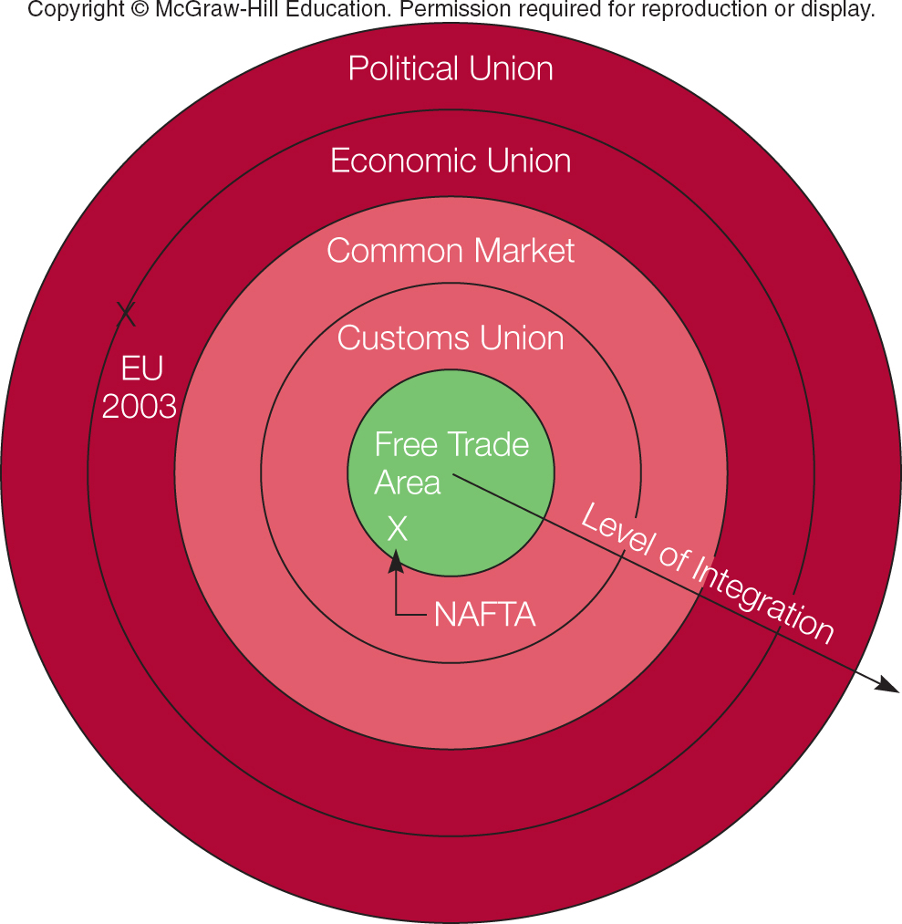
What Are The Levels Of Regional Economic Integration?
Levels of Economic Integration

Slide 43
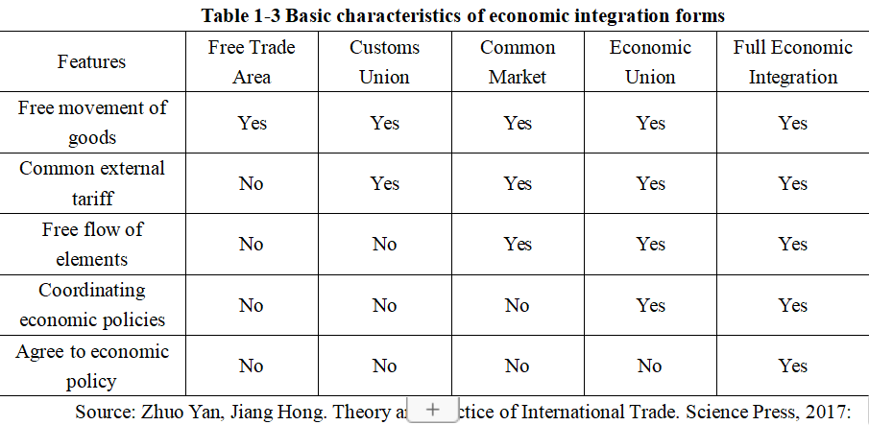
The concept and form of regional economic integration

Slide 44
II. Regional Economic Integration Organizations
- Advanced stage: European Union
- Early stage: North American Free Trade Agreement
- Preliminary stage: Asia-Pacific Economic Cooperation

Slide 45
1. April 1951 – France, Germany, Italy, Netherlands, Belgium and Luxembourg establish the European Coal and Steel Community.
2. 1958 – The six found the European Economic Community and the European Atomic Energy Community; decide to build a customs union and implement a common agricultural policy.
3. 1 July 1967 – The three communities merge into the European Community.
4. December 1991 – The Maastricht Treaty is signed.
5. 1 November 1993 – The Maastricht Treaty enters into force; the European Union is created.
6. 1 January 1999 – The euro is officially launched.
7. 2009 – The Treaty of Lisbon enters into force.
8. 23 June 2016 – The United Kingdom holds a referendum on EU membership; a majority vote to leave.

Slide 46
1. 1988 – The United States and Canada signed the Canada–U.S. Free Trade Agreement.
2. October 1992 – The heads of state of the United States, Canada, and Mexico signed the North American Free Trade Agreement (NAFTA).
3. September 1994 – The United States formally proposed the creation of a Free Trade Area of the Americas (FTAA).
4. December 1994 – At the first Summit of the Americas in Miami, 34 countries of the Americas signed an agreement committing to establish the FTAA.
5. 1998 – At the second Summit of the Americas in Santiago, the negotiations to create the FTAA were officially launched.
6. April 2001 – The third Summit of the Americas, held in Quebec City, Canada, set a firm deadline of December 2005 for the official launch of the FTAA.

Slide 47
1. November 1989 – The first APEC Ministerial Meeting, held in Canberra, marked the formal launch of institutionalized economic cooperation in the Asia-Pacific region.
2. November 1993 – The inaugural APEC Economic Leaders’ Meeting took place in Seattle, USA.
3. November 1994 – The Bogor Meeting set two timelines for achieving trade and investment liberalization.
4. November 1995 – The Osaka Meeting reaffirmed that each member may proceed toward liberalization at its own pace and in its own manner, according to its individual circumstances.
5. November 2014 – The Beijing Meeting launched the process for an Asia-Pacific Free Trade Area and adopted the APEC Roadmap for its realization.

Slide 48
Traditional Model // Asia-Pacific Economic Cooperation (APEC) Approach
1. Traditional: Requires regional integration to be built upon
a complete set of binding institutional rules;
APEC: Adopts voluntary, consensus-based cooperation,
upholding flexibility and non-compulsory principles;
2. Traditional: Advocates the establishment of supranational
authoritative bodies during the integration process;
APEC: Essentially no more than an economic cooperation forum;
3. Traditional: Tends to be exclusive, preferring closed forms of
regional cooperation and showing discrimination
against non-members;
APEC: Has practiced open regionalism from the outset,
applying non-discriminatory principles to non-members as well.

Slide 49
(IV) Other Regional and Sub-regional Organizations
- African Union
- Central American Free Trade Area
- Union of South American Nations
- Community of Latin American and Caribbean States
- Association of Southeast Asian Nations

Slide 50
III. Impetus of International Organizations to Regional Economic Integration
- Jointly advance the deepening of regional integration and greatly enrich its related theories.
- Activities of regional organizations progressively transcend national boundaries and barriers, reinforcing the trend toward regional bloc formation.
- Global organizations continue to regard the development of regional economic integration as an integral part of worldwide economic integration.

Slide 51
Discussion Questions
1. How should we understand the World Trade Organization’s role in advancing the international trading system?
2. How do we assess both the necessity and the limitations of reforming the International Monetary Fund?
3. What advantages do international organizations possess when conducting multilateral aid?
4. What successful lessons has the development of the European Union provided for regional economic integration?

